Slide 1
UNIT -1
POWER SYSTEM NETWORK MATRICES

Slide 2
GRAPH THEORY
The geometrical interconnection of the various branches of a network is called the topology of the network.
The connection of the network topology, shown by replacing all its elements by lines is called a graph.

Slide 3
DEFINITIONS
Connected Graph
Sub-graph
Loop
Cutset
Tree
Co-Tree

Slide 4
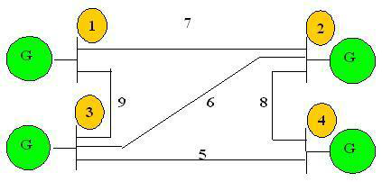
EXAMPLE

Slide 5
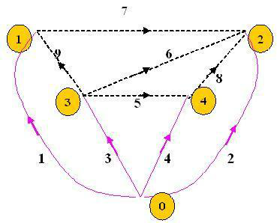
ORIENTED GRAPH

Slide 6
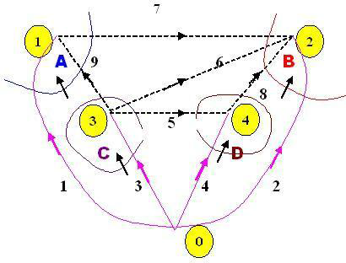
BASIC CUTSETS

Slide 7
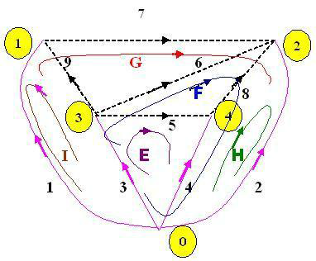
BASIC LOOPS

Slide 8
INCIDENCE MATRICES
Element–node incidence matrix:
The incidence of branches to nodes in a connected graph is given by the element-node

Slide 9
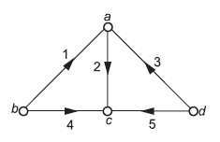
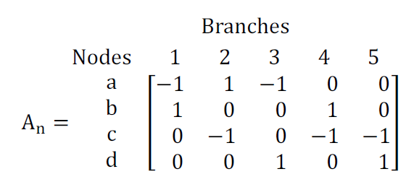
EXAMPLE

Slide 10
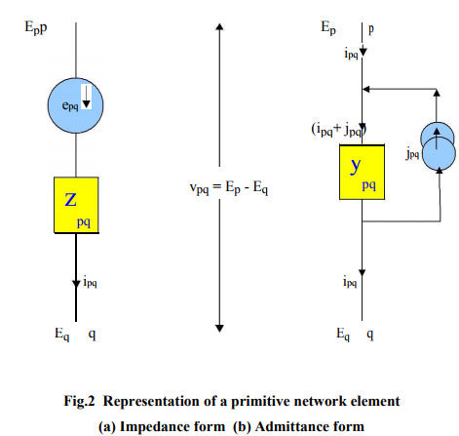
PRIMITIVE NETWORKS

Slide 11
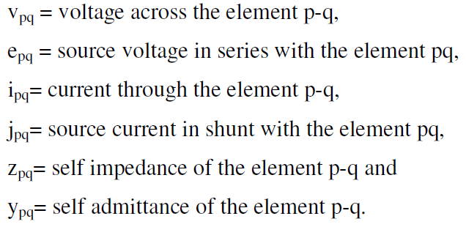
PRIMITIVE NETWORKS

Slide 12
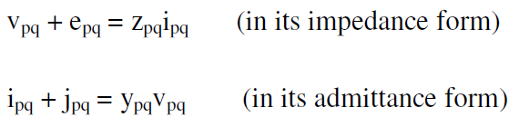
PERFORMANCE EQUATION

Slide 13
BUS ADMITTANCE(Y BUS) MATRIX
Y BUS can be formed by 2 methods
1.Inspection method
2.Singular transformation
Y BUS =

Slide 14
INSPECTION METHOD
For n bus system
Diagonal element of Y BUS
Off Diagonal element of Y BUS

Slide 15
SINGULAR TRANSFORMATION METHOD
Y BUS =
Where [y]=primitive admittance
A=bus incidence matrix

Slide 16
FORMATION OF ZBUS
p is an existing bus in the partial network and q is a new bus; in this case p-q is a branch added to the p-network
Both p and q are buses existing in the partial network; in this case p-q is a link added to the p-network

Slide 17
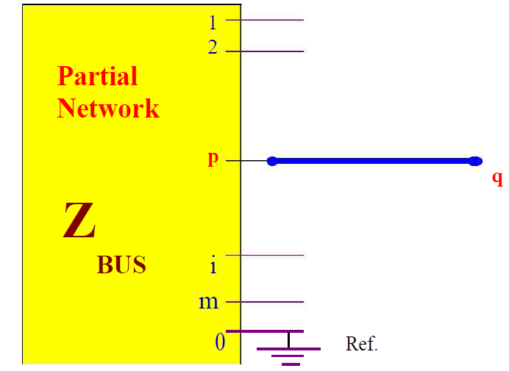
ADDITION OF BRANCH P-Q

Slide 18
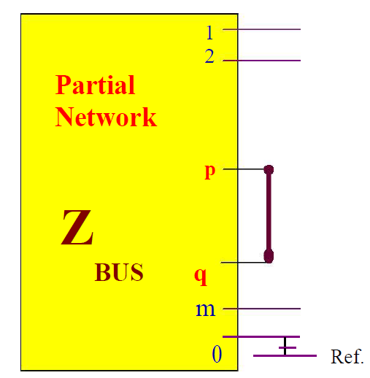
ADDITION OF LINK P-Q

